Slide 1
Conceptual Model
CE3101 - Databases

Slide 2
Disclaimer / Descargo de Responsabilidad
Esta presentación corresponde a una guía usada por el profesor durante las clases. La misma ha sido modificada para ser utilizado en el modelo de cursos asistidos por tecnología. No es una versión final, por lo que la misma podría requerir todavía hacer algunos ajustes. Para aspectos de evaluación esta presentación es solo una guía, por lo que el estudiante debe profundizar con el material de lectura asignado y lo discutido en clases para aspectos de evaluación.
This presentation corresponds to a guide material used by the professor during classes. It has been modified to be used in the model of technology-assisted courses. It is not a final version, so it may still require some adjustments. For evaluation aspects, this presentation is only a guide, so the student should delve with the assigned reading material and what has been discussed in class.

Slide 3
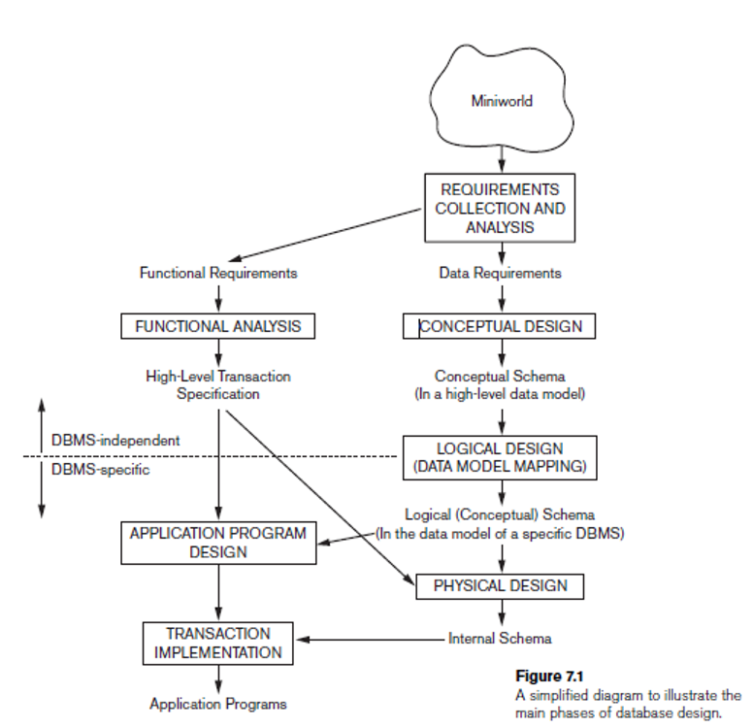
Database Design Process

Slide 4
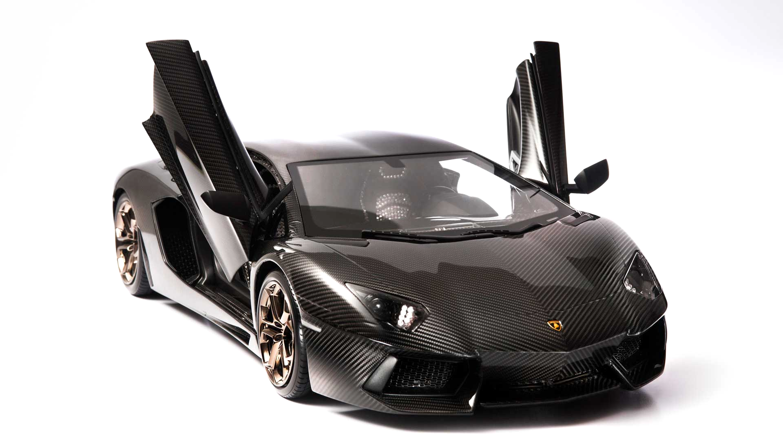
Think about a car...

Slide 5
The car is:
Black
Has doors that open upward
Lamborghini
Made of metal
Heavy
Expensive
Not a Hyundai
The same I have in my garage!

Slide 6
Let’s bake a cake
What objects are involved?

Slide 7
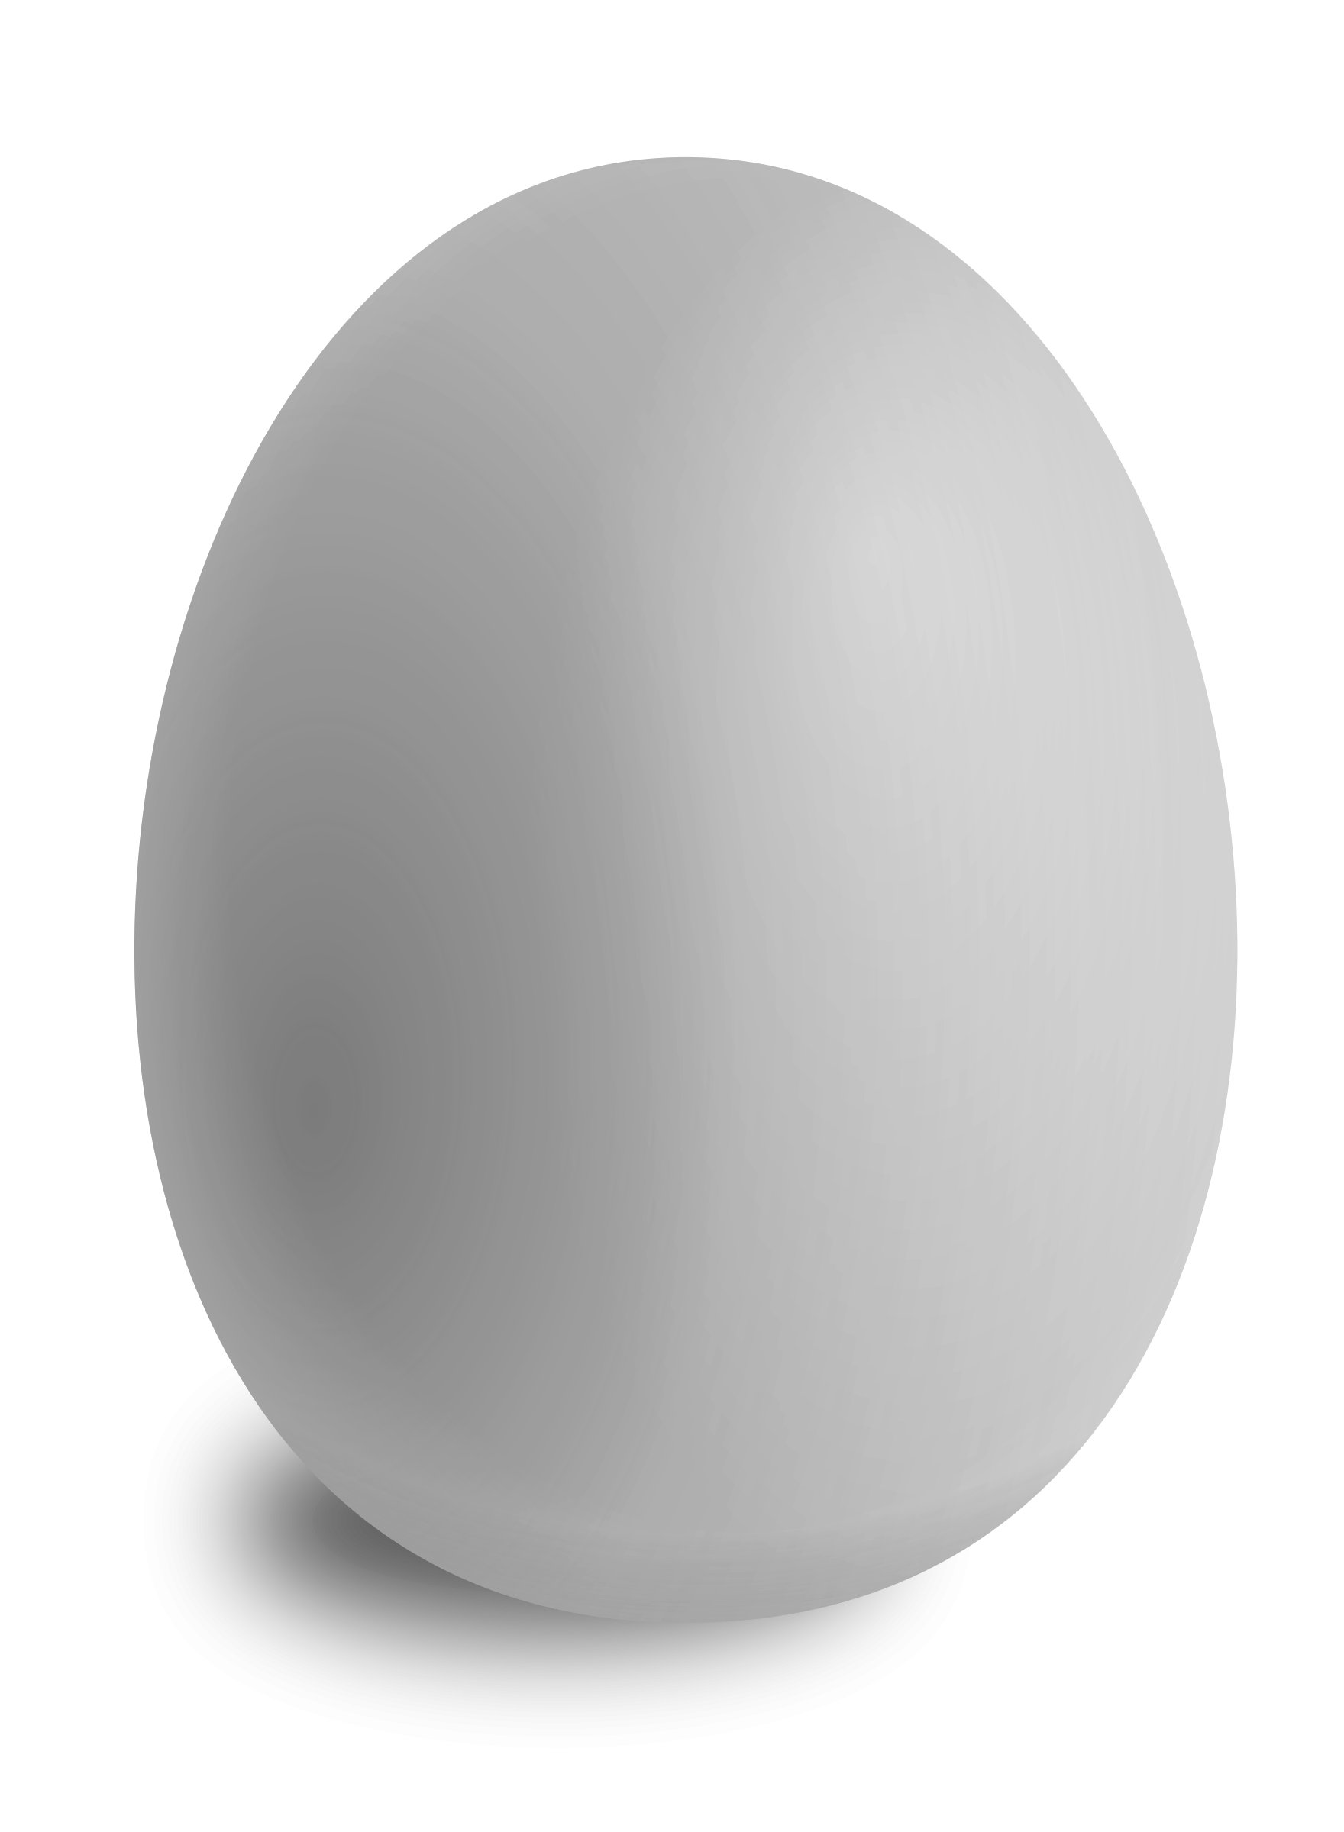
Let’s bake a cake
What objects are involved?

Slide 8
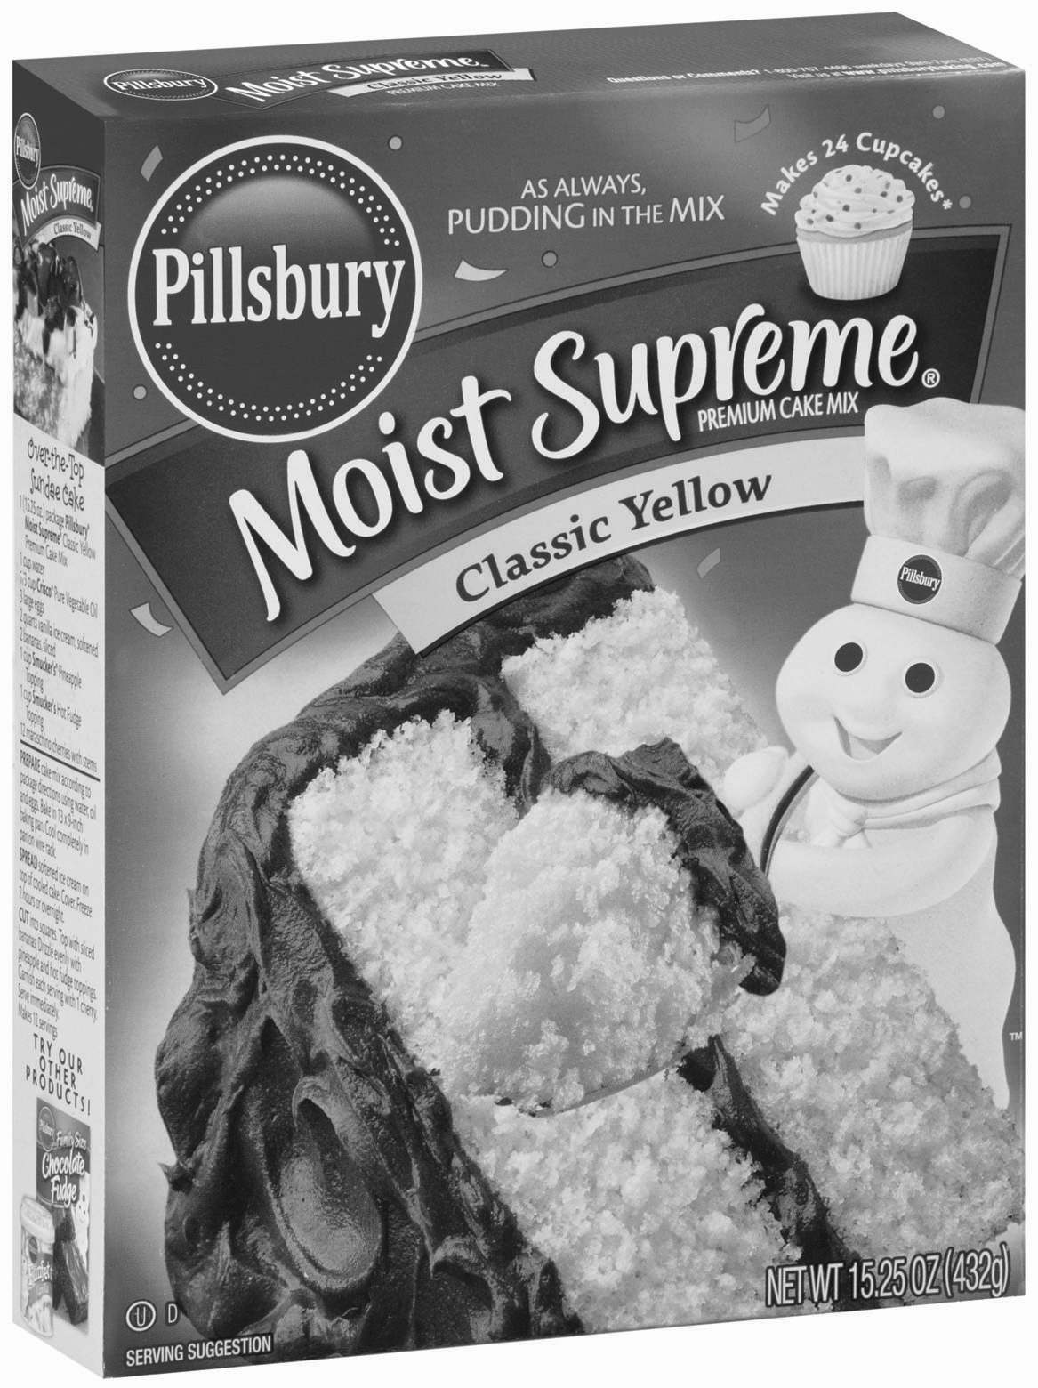
Let’s bake a cake
What objects are involved?

Slide 9
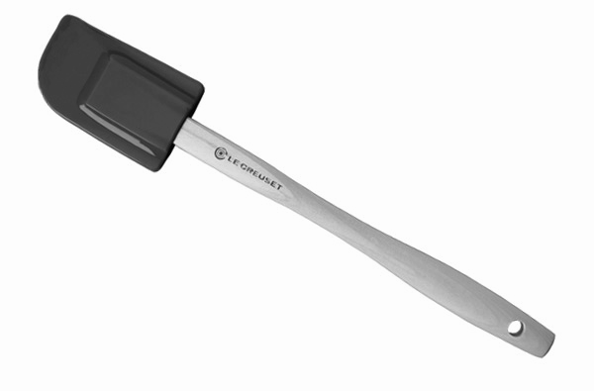
Let’s bake a cake
What objects are involved?

Slide 10

Let’s bake a cake
What objects are involved?

Slide 11
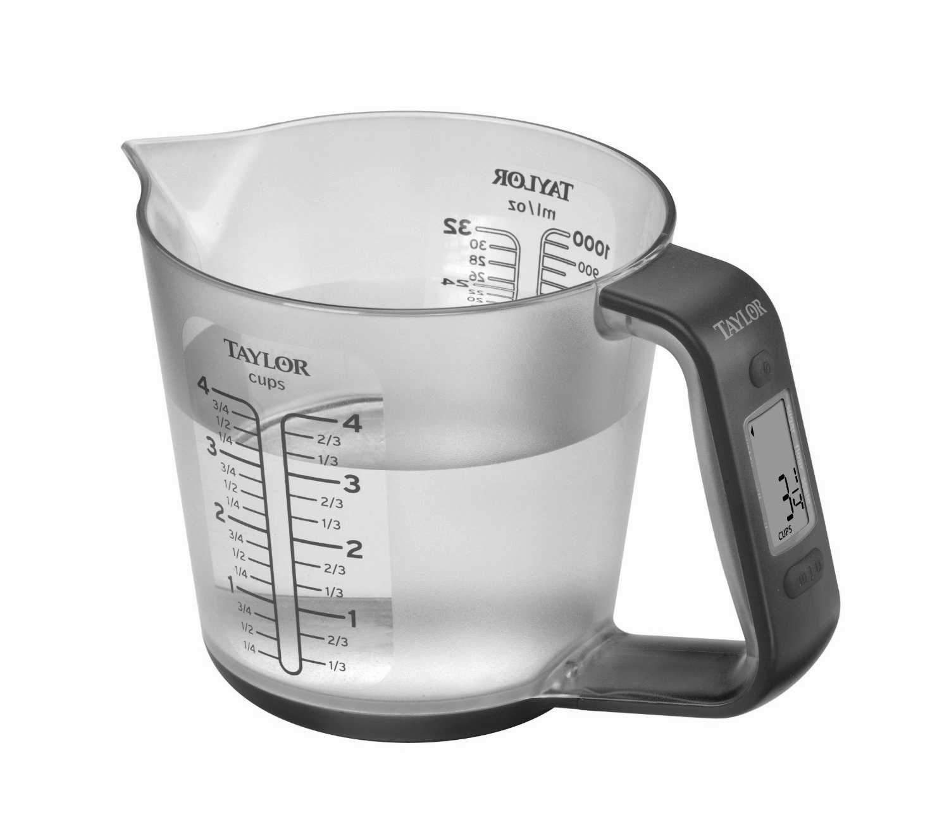
Let’s bake a cake
What objects are involved?

Slide 12
Now define the relationship between the objects

Slide 13
We have to define the attributes of each one
Ok… you need an egg, but what kind of egg?

Slide 14

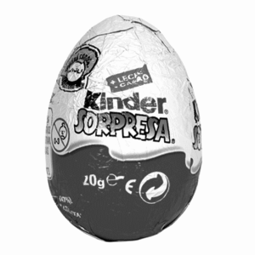
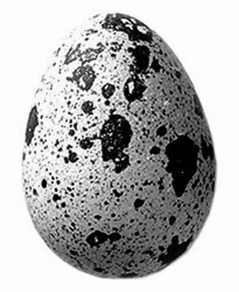
We have to define the attributes of each one
Ok… you need an egg, but what kind of egg?

Slide 15
Ejercicio Modelado del Contexto de un Problema

Slide 16
Entities and Attributes
The basic object that the ER Model represents is an entity, which is a thing in the real world with an independent existence.
Each entity has attributes. Particular properties that describe it.

Slide 17
Entities and Attributes
ENTITY
EXAMPLE
The basic object that the ER Model represents is an entity, which is a thing in the real world with an independent existence.
REPRESENTED BY

Slide 18
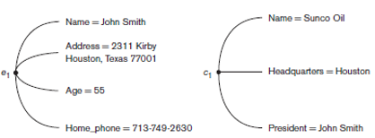
Entities and Attributes
ENTITY
EXAMPLE
The basic object that the ER Model represents is an entity, which is a thing in the real world with an independent existence.
REPRESENTED BY

Slide 19

Entities and Attributes
ENTITY
EXAMPLE
The basic object that the ER Model represents is an entity, which is a thing in the real world with an independent existence.
REPRESENTED BY

Slide 20
Entities and Attributes
ATTRIBUTES
EXAMPLE
Each entity has attributes. Particular properties that describe it.
REPRESENTED BY

Slide 21
Entities and Attributes
ATTRIBUTES
EXAMPLE
Each entity has attributes. Particular properties that describe it.
REPRESENTED BY

Slide 22

Entities and Attributes
ATTRIBUTES
EXAMPLE
Each entity has attributes. Particular properties that describe it.
REPRESENTED BY

Slide 23
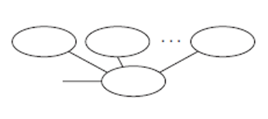
Attributes
COMPOSITE ATTRIBUTES
Attribute divided into smaller parts. Represents more basic attributes with independent meanings.

Slide 24
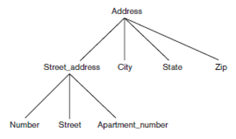
Attributes
COMPOSITE ATTRIBUTES
For example, the address attribute of the EMPLOYEE

Slide 25
Attributes
Are useful to model situations on which a user sometimes refers to the composite attribute as a unit but at other times refers specifically to its components.
COMPOSITE ATTRIBUTES
For example, the address attribute of the EMPLOYEE

Slide 26
Attributes
COMPOSITE ATTRIBUTES
For example, the address attribute of the EMPLOYEE
SINGLED-VALUED ATTRIBUTES
Has a single value for particular entity.

Slide 27

Attributes
MULTIVALUED ATTRIBUTES
Can have a set of values for the same entity.

Slide 28
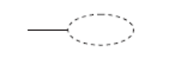
Attributes
MULTIVALUED ATTRIBUTES
Can have a set of values for the same entity.
STORED AND DERIVED
In some cases, two (or more) attribute values are related.
Stored. Attribute that has the value.
Derived. Attribute that depends of other attribute to assign a value.

Slide 29
Attributes
MULTIVALUED ATTRIBUTES
Can have a set of values for the same entity.
STORED AND DERIVED
In some cases, two (or more) attribute values are related.
Stored. Attribute that has the value.
Derived. Attribute that depends of other attribute to assign a value.

Slide 30
Attributes
MULTIVALUED ATTRIBUTES
Can have a set of values for the same entity.
STORED AND DERIVED
For a particular person entity, the value of Age can be determined from the current (today’s) date and the value of that person’s Birth date. The Age attribute is hence called a derived attribute and is said to be derivable from the Birth date attribute, which is called a stored attribute.

Slide 31
Attributes
NULL VALUES
In some cases, a particular entity may not have an applicable value for an attribute.

Slide 32
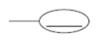
Attributes
NULL VALUES
In some cases, a particular entity may not have an applicable value for an attribute.
KEY ATTRIBUTES
Uniqueness constraint.
One or more attributes whose values are distinct for each individual entity in the entity set.

Slide 33
Key Attributes
The car’s vehicle identification number (VIN) is the identifying code for a specific automobile. The VIN serves as the car’s fingerprints, as no two vehicles in operation have the same VIN.

Slide 34
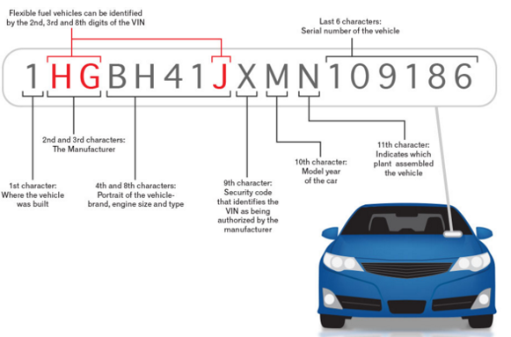
Key Attributes
The car’s vehicle identification number (VIN) is the identifying code for a specific automobile. The VIN serves as the car’s fingerprints, as no two vehicles in operation have the same VIN.

Slide 35
Key Attributes of an Entity Type
An important constraint on the entities of an entity type is the key or uniqueness constraint on attributes.
An entity type usually has one or more attributes whose values are distinct for each individual entity in the entity set. Such an attribute is called a key attribute.

Slide 36
Value Sets (Domains) of Attributes
Each simple attribute of an entity type is associated with a value set (or domain of values), which specifies the set of values that may be assigned to that attribute for each individual entity.

Slide 37
Pregunta inicial
Cuál es el único animal que solo tiene un oido?

Slide 38
Study Case
The company is organized into departments. Each department has a unique name, a unique number, and a particular employee who manages the department. We keep track of the start date when that employee began managing the department. A department may have several locations.
A department controls a number of projects, each of which has a unique name, a unique number, and a single location.
We store each employee’s name, Social Security number,2 address, salary, sex(gender), and birth date. An employee is assigned to one department, but may work on several projects, which are not necessarily controlled by the same department. We keep track of the current number of hours per week that an employee works on each project. We also keep track of the direct supervisor of each employee (who is another employee).
We want to keep track of the dependents of each employee for insurance purposes. We keep each dependent’s first name, sex, birth date, and relationship to the employee.

Slide 39
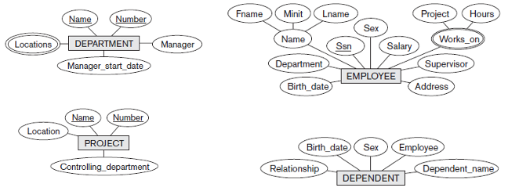
Study Case

Slide 40
Respuesta a pregunta inicial
La mantis religiosa. Situado en el torax y no en la cabeza.

Slide 41
Pregunta inicial
Aparte de las huellas dactilares qué otras partes del cuerpo humano sirven como marca de identidad?

Slide 42
Relationship Types, Relationship Sets, Roles and
Structural Constraints

Slide 43
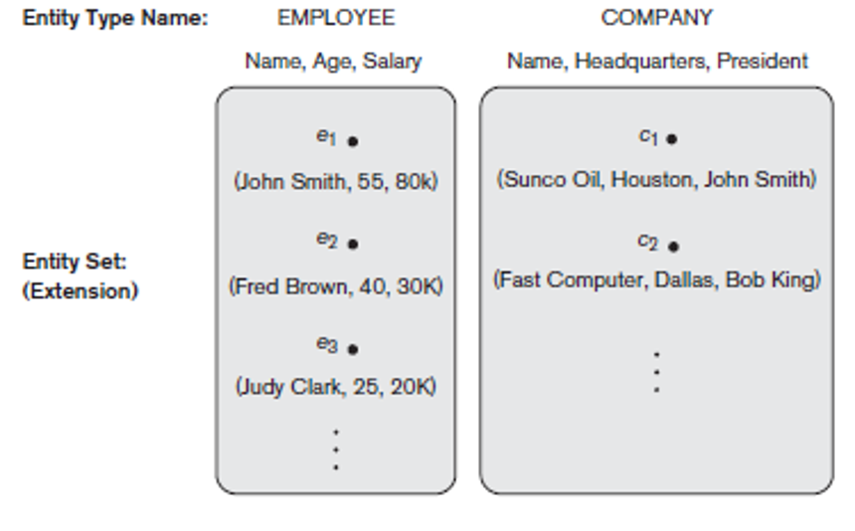
Entity Type, Instances and Entity Sets

Slide 44

Relationship
DEFINITION
SYMBOL
Whenever an attribute of one entity refers to another entity type, some relationship exists.
In the ER model, these references should not be represented as attributes but as relationships.

Slide 45
Relationship Types
A relationship type R among n entity types defines a set of associations among entities from these entity types.
E1, E2, E3…, En
Formally. Relationship set is a mathematical relation on
E1, E2, E3, …, En
can be defined as a subset of the Cartesian Product of the entity sets
E1 x E2 x E3 x … x En
Each of the entity types E1, E2, E3, …, En is said to participate in the relationship type R.

Slide 46
Relationship Types
A relationship type R among n entity types defines a set of associations among entities from these entity types.
E1, E2, E3…, En
Formally. Relationship set is a mathematical relation on
E1, E2, E3, …, En
can be defined as a subset of the Cartesian Product of the entity sets
E1 x E2 x E3 x … x En
Each of the entity types E1, E2, E3, …, En is said to participate in the relationship type R.
(Informally) Each relationship instance r_{i} in R is an association of entities, where the association includes exactly one entity from each participating entity type.

Slide 47
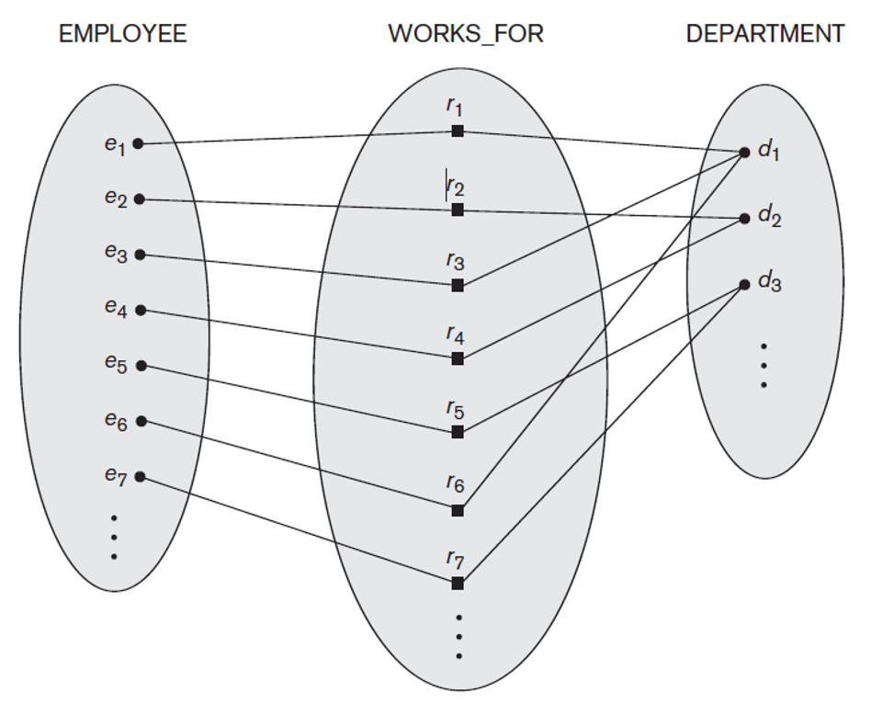
Relationship Types

Slide 48
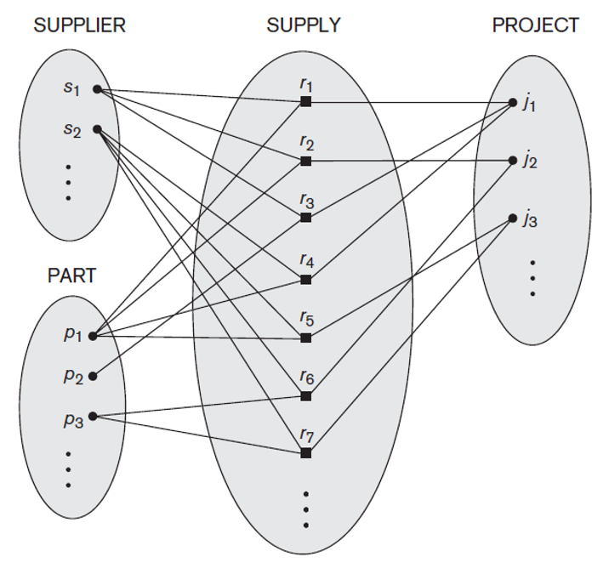
Degree of a Relationship Type
The degree of a relationship type is the number of participating entity types.
A relationship type of degree two is called binary, and one of degree three is called ternary.

Slide 49
Role Name and Recursive Relationships
ROLE NAME
RECURSIVE RELATIONSHIP
Helps to explain what the relationship means. Role that participating entity plays in relationship instance.
The same entity participates more than once in a relationship.

Slide 50
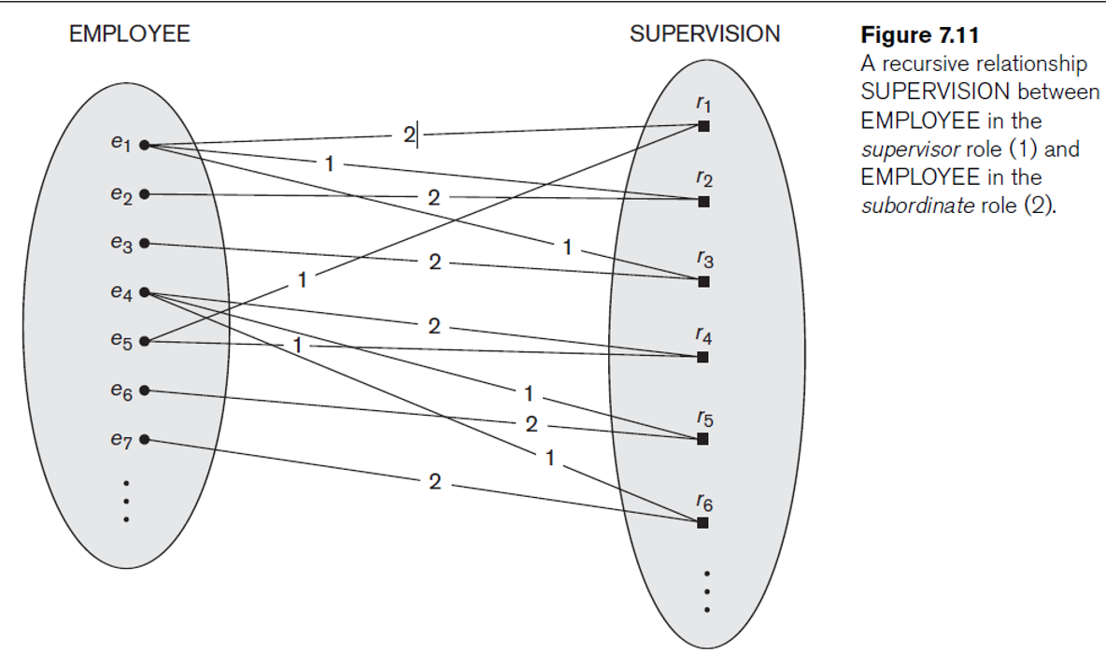
Role Name and Recursive Relationships

Slide 51
Constraints on Binary Relationship Types
Relationship types usually have certain constraints that limit the possible combinations of entities that may participate in the corresponding relationship set.
These constraints are determined from the miniworld situation that the relationships represent.
We can distinguish two main types of binary relationship constraints :
Cardinality radio.
Participation.

Slide 52
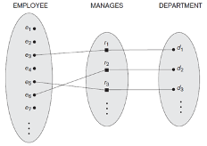
Constraints on Binary Relationship Types
Relationship types usually have certain constraints that limit the possible combinations of entities that may participate in the corresponding relationship set.
These constraints are determined from the miniworld situation that the relationships represent.
We can distinguish two main types of binary relationship constraints :
Cardinality radio. Specifies the maximum number of relationship instances that an entity can participate in.
Participation.

Slide 53
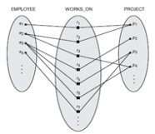
Constraints on Binary Relationship Types
Relationship types usually have certain constraints that limit the possible combinations of entities that may participate in the corresponding relationship set.
These constraints are determined from the miniworld situation that the relationships represent.
We can distinguish two main types of binary relationship constraints :
Cardinality radio. Specifies the maximum number of relationship instances that an entity can participate in.
Participation.

Slide 54
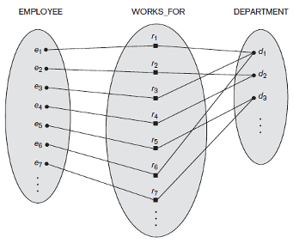
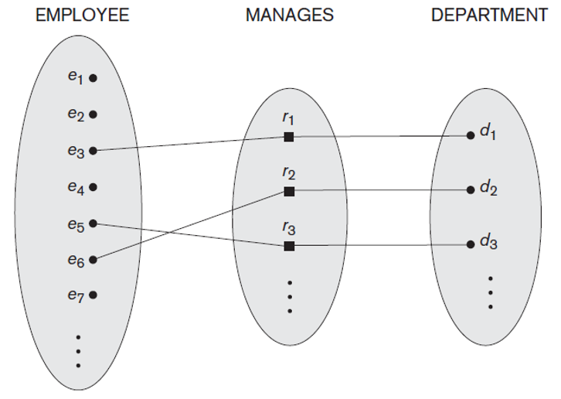
Participation Constraints and Existence Dependencies
Specifies when the existence of an entity depends on being related to another entity.
There are two types of participation constraints:
Total Partial

Slide 55
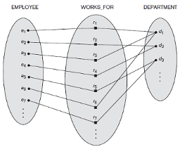
Attributes of Relationship Types
Relationship types can also have attributes, similar to those of entity types.

Slide 56
Attributes of Relationship Types
Relationship types can also have attributes, similar to those of entity types.
Example: Number of hours per week that an employee works on a particular project

Slide 57
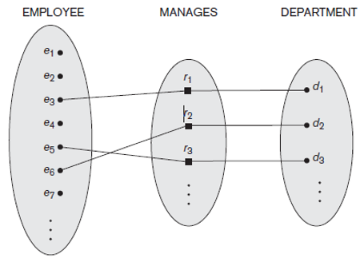
Attributes of Relationship Types
Relationship types can also have attributes, similar to those of entity types.
Notice that attributes of 1:1 or 1:N relationship types can be migrated to one of the participating entity types.

Slide 58
Attributes of Relationship Types
Relationship types can also have attributes.
StartDate?
1:1 RELATIONSHIP
1:N RELATIONSHIP
StartDate for MANAGES relationship can be an attribute of EMPLOYEE or DEPARTMENT

Slide 59
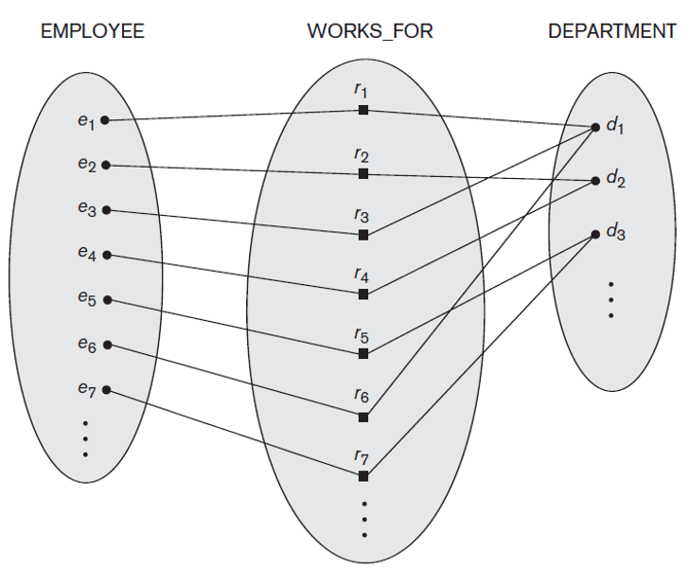
Attributes of Relationship Types
Relationship types can also have attributes.
StartDate?
1:1 RELATIONSHIP
1:N RELATIONSHIP
StartDate for MANAGES relationship can be an attribute of EMPLOYEE or DEPARTMENT.
Attribute can be migrated only to the entity type on the N-side of the relationship.

Slide 60

Weak Entity Types
DEFINITION
SYMBOL
Entity types that do not have key attributes of their own.
A weak entity type always has a total participation constraint (existence dependency) with respect to its identifying relationship because a weak entity cannot be identified without an owner entity.
Both a weak entity type and its identifying relationship are distinguished by surrounding their boxes and diamonds with double lines.

Slide 61
Weak Entity Types
Weak entity types can sometimes be represented as complex (composite, multivalued) attributes.
DEFINITION
SYMBOL
Entity types that do not have key attributes of their own.
A weak entity type always has a total participation constraint (existence dependency) with respect to its identifying relationship because a weak entity cannot be identified without an owner entity.
Both a weak entity type and its identifying relationship are distinguished by surrounding their boxes and diamonds with double lines.

Slide 62
Proper Naming of Schema Constructs
We choose to use singular names for entity types, rather than plural ones, because the entity type name applies to each individual entity belonging to that entity type.
In our ER diagrams, we will use the convention that entity type and relationship type names are uppercase letters, attribute names have their initial letter capitalized.

Slide 63
Proper Naming of Schema Constructs
As a general practice, given a narrative description of the database requirements:
The nouns appearing in the narrative tend to give rise to entity type names.
The verbs tend to indicate names of relationship types.
Attribute names generally arise from additional nouns that describe the nouns corresponding to entity types.

Slide 64
Respuesta a pregunta inicial
Aparte de las huellas dactilares, el aroma y la lengua de cada persona también es una marca de identidad, de hecho este ultimo tiene huellas únicas e irrepetibles

Slide 65
Study Case
The company is organized into departments. Each department has a unique name, a unique number, and a particular employee who manages the department. We keep track of the start date when that employee began managing the department. A department may have several locations.
A department controls a number of projects, each of which has a unique name, a unique number, and a single location.
We store each employee’s name, Social Security number,2 address, salary, sex(gender), and birth date. An employee is assigned to one department, but may work on several projects, which are not necessarily controlled by the same department. We keep track of the current number of hours per week that an employee works on each project. We also keep track of the direct supervisor of each employee (who is another employee).
We want to keep track of the dependents of each employee for insurance purposes. We keep each dependent’s first name, sex, birth date, and relationship to the employee.

Slide 66
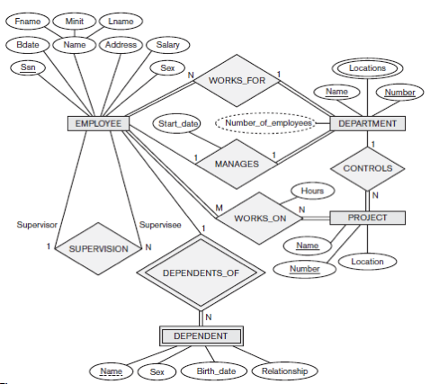
Study Case

Slide 67
Study Case (Taller #1)

Slide 68
Conceptual Model
CE3101 - Databases

